Slide 1


Welcome!
Please sign in
Or use link: http://bit.ly/C4C-2920

Slide 2
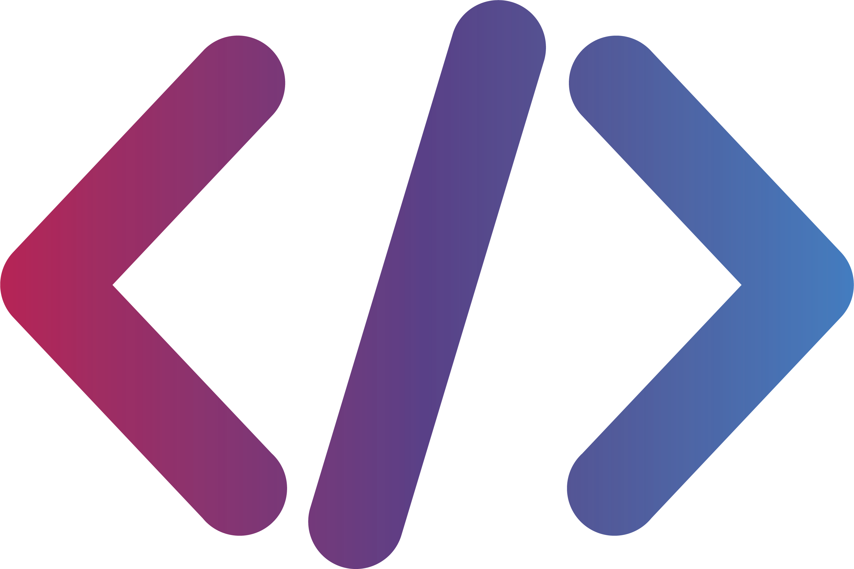
Development Workshop 1
Intro to Backend Development and APIs
1
Notes:
Today we’re going to be going over the MVC architecture pattern that some of you may have learned in OOD, and see how we can use this to develop an API for a microservice.
First we will go over some definitions of API and microservice and how they relate to web development, then we’re going to go over the MVC pattern and some quick general examples, and finally we’re going to look at an actual API implementation and how we can design it in a way to enforce the principles of MVC.

Slide 3
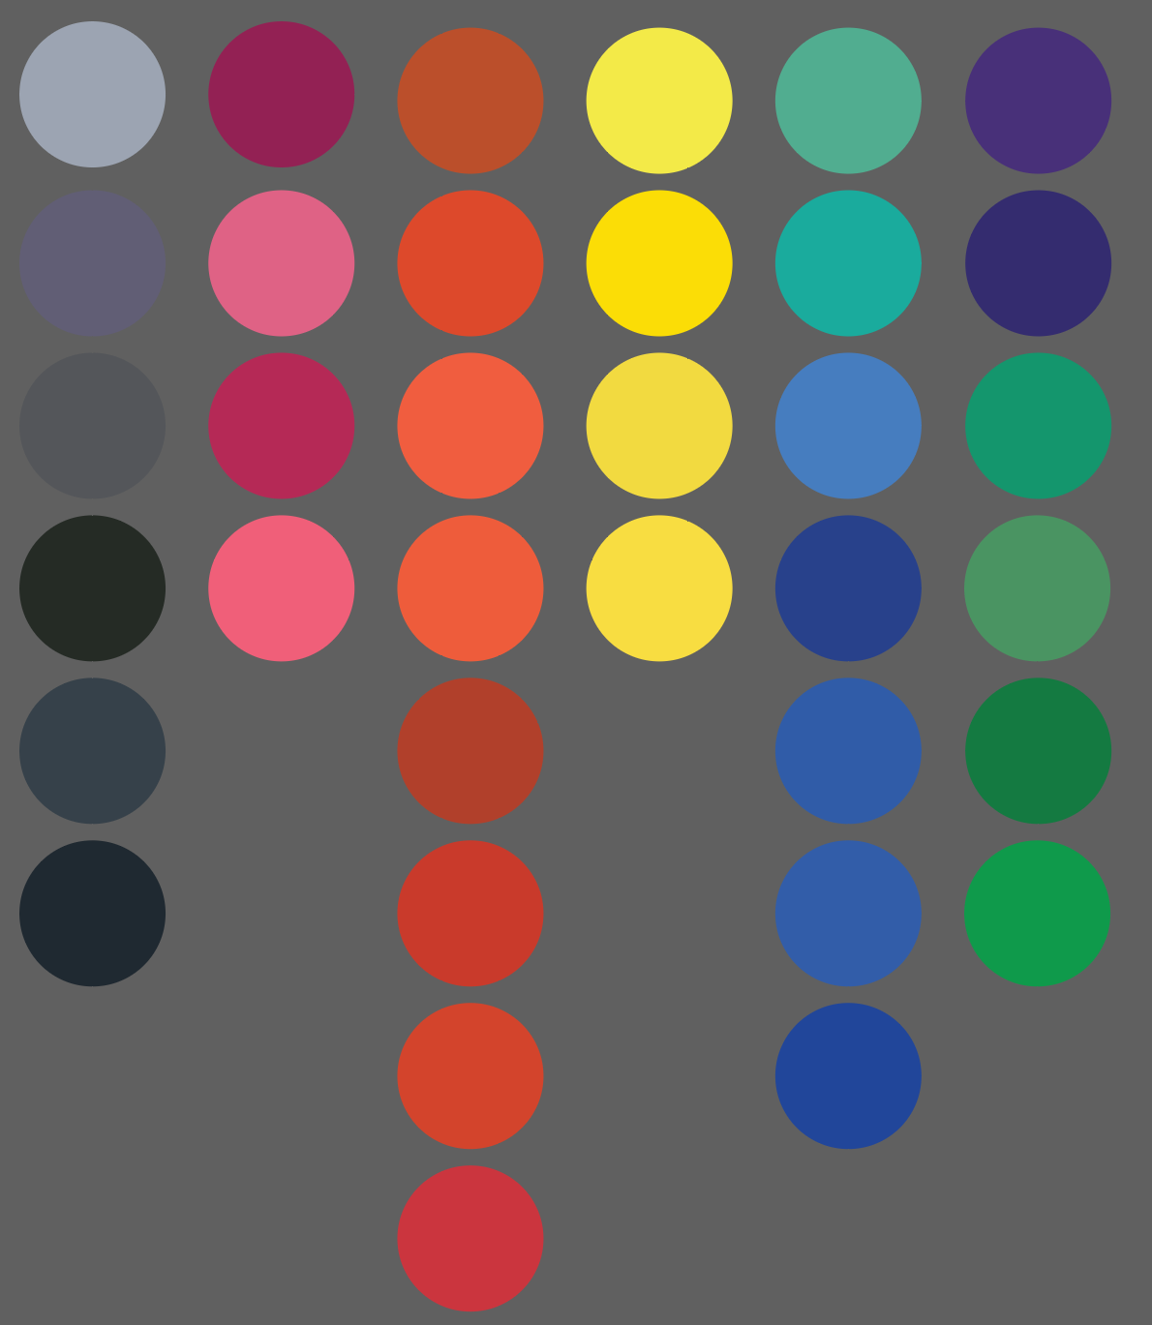

Key Concepts
1
What is a backend developer? And, what do they typically do?
2
What is an API? And, How can they be used in web application development?
3
What are the different types of backend architectures? And, what are the pros and cons?
2
Notes:
These are some quick Key Concepts that I hope you’ll come away from this workshop having a better idea about.
Keep in mind that there are a lot of different skill levels in the room right now, I tried to find a balance that would be approachable to beginners but wouldn’t completely bore more experienced people. That being said, if you don’t understand something make a note of it and after the workshop you can either ask any of the E-Board members or do your own research afterwards. Similarly, if you already know what I’m talking about please just be respectful for the sake of everyone else.

Slide 4
An Introduction to the MVC Pattern
Each letter represents a different abstract part of an application where each part’s responsibilities are decoupled from each other’s part
MVC stands for Model-View-Controller
Encapsulates all the data of the application and the logic of how it can be changed
Displays the content to the user
Handles input from the user and tells the view and the model how to interact with each other
3
Model
View
Controller
Notes:
So I think I said it already earlier in the presentation but who can tell me what MVC stands for?
The model is in charge of maintaining the “state” of the application, it remembers what all the data is and it’s in charge of maintaining and updating the data as the application exists.
The view is in charge of displaying the state of the application, it’s the outward facing state of the application.
The controller can be thought of as the bridge between the view and the model. It can handle user input on the view and interprets it into something that it can tell the model, it can then deliver the new application state back to the view.
Just be aware that the lines between the model and the controller can get a little blurred sometimes as to which one is meant to handle all of the logic. I like to think of it as the model holds the logic of what can possibly done while the controller holds the logic of what is being done at the time.
Notice how the goals of the MVC pattern and the microservice architecture are the same, they’re both trying to separate responsibilities and keep different pieces of the code from interacting with each other.

Slide 5
MVC in a Web Application
Frontend (View)
UI
UI
Billing Business Logic
Customer Business Logic
Billing Business Logic
Customer Business Logic
Event Business Logic
Event Business Logic
Backend (Controller)
Data Access Layer
Data Access Layer
Database (Model)
Database
Database
4
Notes:
What do you think the top section is? Middle? Bottom?
Model: Stores all the data that is persisted in the application.
View: Displays the webpage to the user.
Controller: Handles all the internal logic for translating user clicks to database transactions.
The big difference between this and MVC for a single Java application that you’re taught in OOD is that this controller will be doing a lot more work to decide what has to be done to the model. Expand on this?

Slide 6
What is Backend?
This includes any complicated action a user might want to make or any actions that requires the database
The backend is essentially the “Controller” of an application
Backend development is the closest form of web development to “fill-in-the-function” coding that beginners usually see.
The backend handles all of an application’s business logic
5

Slide 7
How Does the Backend Interact with the Rest of the Application?
Talking to the Frontend
Talking to the Database
METHOD CALLS
SQL
Communicating directly through method calls in a code base
The standard language for making queries on traditional databases
APIs
ORMs
A standardized messaging format system for distributed applications to communicate with
Object relational mapping, essentially abstracting SQL into code
6
Notes:
ONLY CLICK ONCE!

Slide 8
What is an API?
An Application Protocol Interface defines how 2 applications can communicate to one another
APIs exist to standardize how 2 applications on different computers can communicate with each other over a network
A web-based API defines a standard set of endpoints for a web server that clients can send HTTP requests to
7
Notes:
0. See if anyone can define the acronym API and can give a definition of what it is
1. There are many different types of APIs for all kinds of different applications but we are primarily concerned with web-based API that defines how actors on the internet communicate to one another.
2.
Web Server: A web server can be thought of as an entity on the internet that is providing content, like a certain web site.
Client: A client is an entity on the internet that is consuming content. Your browser when you go to youtube.com for example is a client that is requesting content from the web server that is youtube.
HTTP request: A standardized way to create messages for communication on the web. An HTTP request is basically the message that the client sends and the API is the definition of how a web server will respond to any given message.
Endpoint: A request of a certain “style” that a server has defined and expects.
3.
The VERB can be a bunch of different things but the most common ones are “GET” which is used to get some kind of data and “POST” which is used to create some kind of data.
The web-server-name can be the name of a website that you’re querying or if you’re creating an API on your own computer you’ll typically be using localhost:portnumber
The endpoint-path is going to depend on the API but it will typically be resources separated by forward slashes
4.
Requests can also optionally include some body data, usually GET requests won’t include a body but a POST request will. The bodies can be in a bunch of different formats. Most people will be using JSON as their format.
5.
Web servers will always send a response to a client after an API request, a status code is a number that represents if the request was successful or not, you can look up a list of what different status codes mean but really just know 200 means OK and anything in the 4XXs means NOT OK.

Slide 9
More on HTTP
HTTP requests tend to follow the pattern of:
“VERB web-server-name/endpoint-path”
Example:
“GET youtube.com/users/liam/videos”,
“POST localhost:800/staff/waiters/joey”
Requests also have headers that provide meta-deta and an optional body that can include extra information about the request
Web servers will respond to requests with responses that typically have a status code, more headers, and an optional body
8

Slide 10
Let’s Build a
Backend!

